Slide 1
19CS3113S
Analysis and Design of Algorithms
Session -29

Slide 2
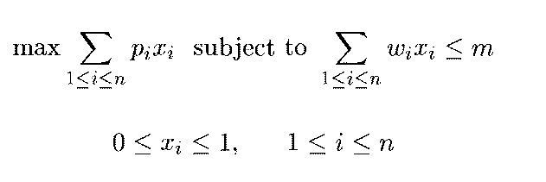
0/1 Knapsack Problem
The problem is similar to the zero-one (0/1) knapsack optimization problem is dynamic programming algorithm.
We are given ‘n’ positive weights Wi and ’n’ positive profits Pi, and a positive number ‘m’ that is the knapsack capacity, the is problem calls for choosing a subset of the weights such that,

Slide 3
The Solution space is the same as that for the sum of subset’s problem.
Bounding functions are needed to help kill some live nodes without expanding them. A good bounding function for this problem is obtained by using an upper bound on the value of the best feasible solution obtainable by expanding the given live node.
Solution :
After assigning the profit and weights ,we have to take the first object weights and check if the first weight is less than or equal to the capacity, if so then we include that object (i.e.) the unit is 1.(i.e.) K🡪 1.

Slide 4
Then We are going to the next object, if the object weight is exceeded that object does not fit. So unit of that object is ‘0’.(i.e.) K=0.
Then We are going to the bounding function ,this function determines an upper bound on the best solution obtainable at level K+1.
Repeat the process until we reach the optimal solution.
Example:
  P={11,21,31,33,43,53,55,65}
  W={1,11,21,23,33,43,45,55}
  m=110 and n=8.
The greedy solution corresponding to the root node is x={1,1,1,1,1,21/45,0,0} and the value is 164.88.

Slide 5
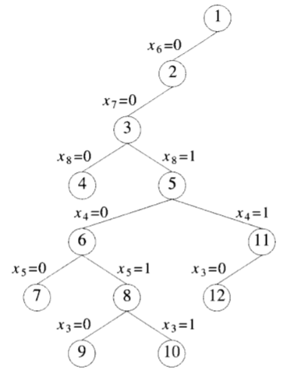
Part of dynamic state spacce tree generated for above problem is:

Slide 6
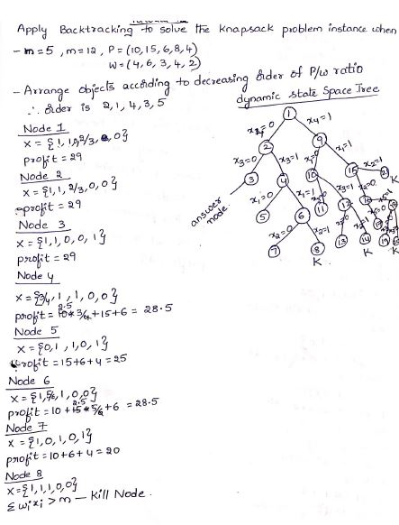

Slide 7
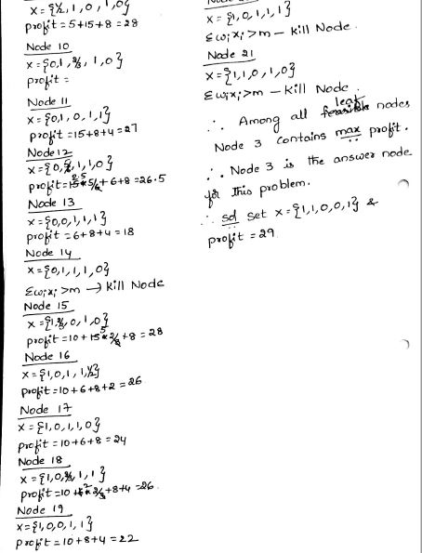

Slide 8
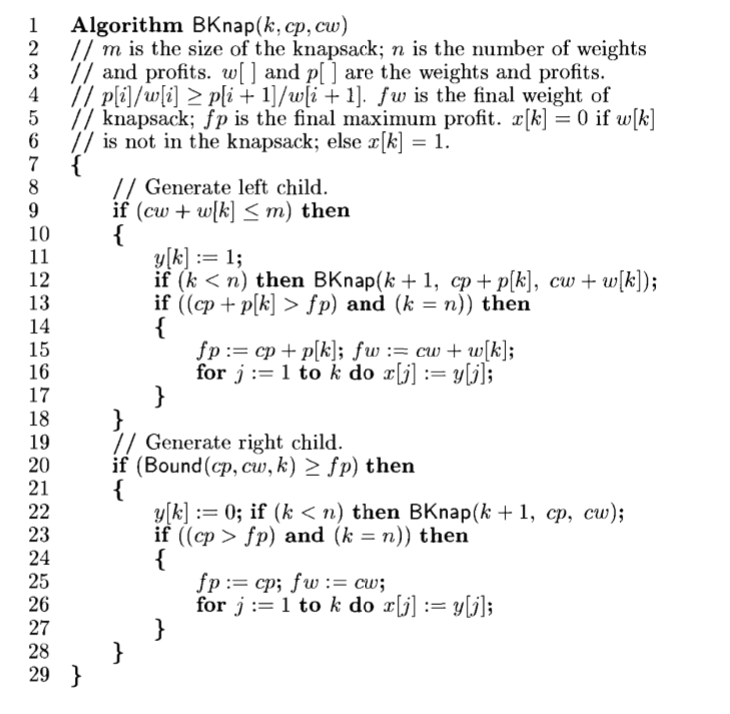
Algorithm: Backtrackingsolutionto the 0/1knapsackproblem:

Slide 9
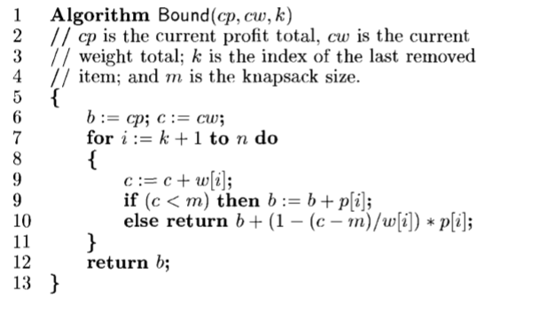
Algorithm for bounding function:

Slide 10
Thank you

